Slide 1
PROJECT A5MMS
Prepared by: Lopez, Carlucenne Dela Custa, Georgette Naperi, Jayson Rocero, Earl Jerome

Slide 2
PROJECT OVERVIEW

Slide 3
What is A5MMS?
-It is a corporation that manages on manpower/janitorial Services

Slide 4
Issues of A5MMS
Highly qualified employees
Accessible information on available jobs
Manual, Time-consuming application and employment processes
Secured and automated payroll system

Slide 5
Process of application and employment
Applicant personally inquires for a job.
Applicant applies and submits requirements to the agency.
Agency process and file submitted requirements.
Agency conducts initial interview then training.
Agency endorses qualified applicants to the A5MMS’ clients.
A5MMS’ client conducts final interview to the qualified applicant and hires qualified applicants.
Notes:
Because of this the purpose of the project is to provide a Human Resource Management System, That will minimize the afore mentioned issues.

Slide 6
Objectives
General Objective
To be able to design and develop a web – based Human Resource Management System for the Area 5 Manpower Management Services (A5MMS).
Specific Objectives
To increase the number of qualified applicants assessed by the agency by 20% in annual basis.
To provide faster transaction on application process of applicants by less than a day.
To provide faster and more secured payroll computation and distribution of pay slip to the employees by 50% every cut - off period.

Slide 7
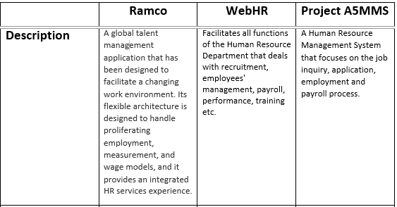
Review of Related Software

Slide 8
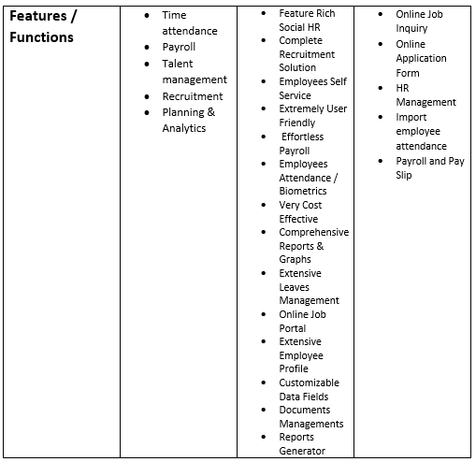
Review of Related Software (continuation)

Slide 9
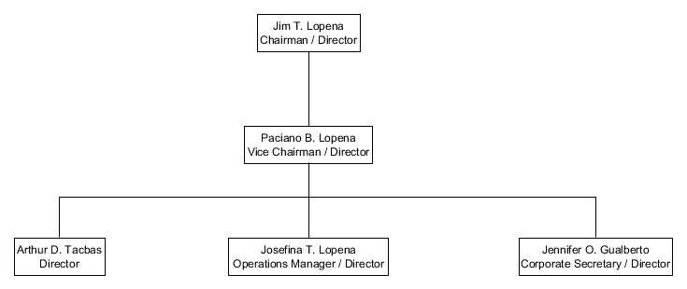
Organizational Charts
Agency

Slide 10
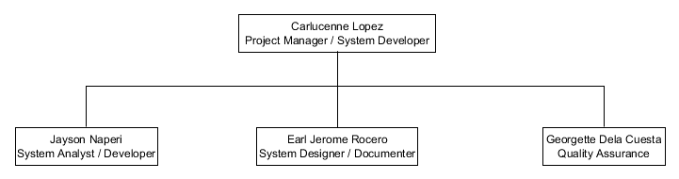
Organizational Charts
Team

Slide 11
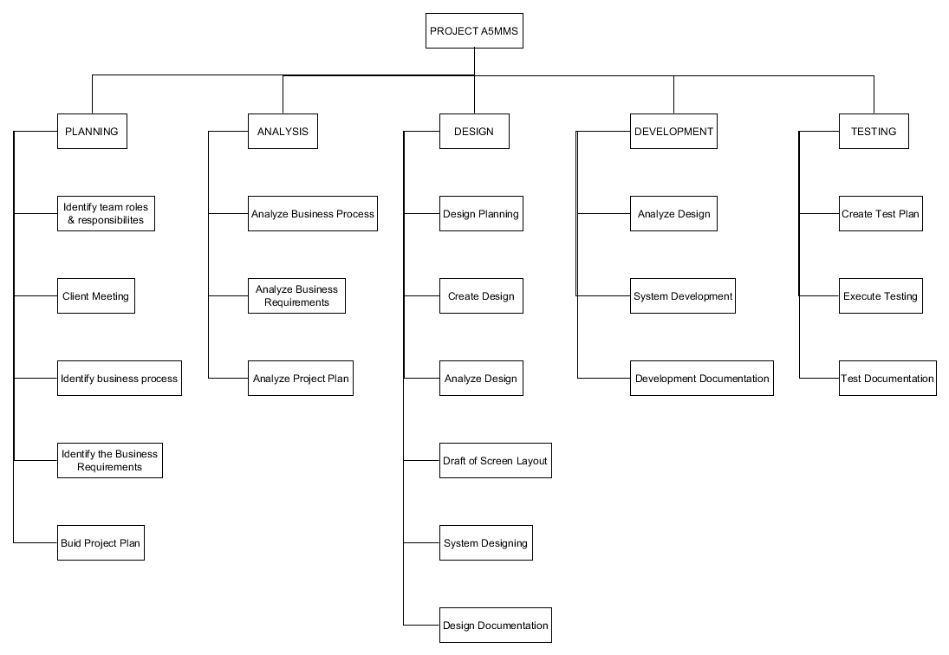
Work Breakdown Structure

Slide 12
Benefits
New Client Opportunity
Increase of Applicants
Automated Payroll System
Notes:
New Client Opportunity
-This benefit may occur because of faster employment process or endorsement highly qualified applicants
Increase of Applicants
-This benefit occurs because of faster application process.
Automated Payroll System
-Faster computation of payroll of employees.

Slide 13
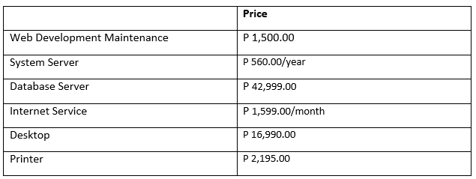
Costs
Operational Cost
Prices are based on:
Servers:
www.asianic.com.ph/product_list/servers
Website Hosting:
www.domainwink.com/hosting
Desktop:
www.ph.priceprice.com/desktops/
Printers
www.canon.com.ph/PRODUCTS/PRINTERSFACSIMILES/PrinterPrices.aspx

Slide 14
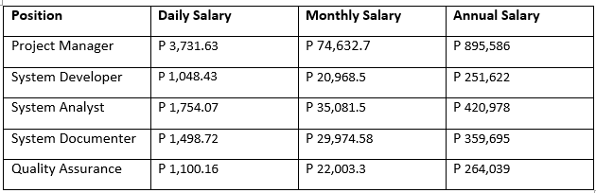
Costs (continuation)
Labor Cost
Based on: www.payscale.com/research/salary

Slide 15
Costs (continuation)
STAGE |  | NO. OF PERSONEL | MAN DAYS | DAILY SALARY | LABOR COST
PLANNING
TOTAL COST(STAGE): | Project Manager | 1 | 5 | 3,731.63 | 18,658.15
34,559.25 | Developer | 1 | 3 | 1,048.43 | 3,145.29
 | Analyst | 1 | 3 | 1,754.07 | 5,262.21
 | Technical Writer | 1 | 5 | 1,498.72 | 7,493.60
DESIGN
TOTAL COST(STAGE): | Project Manager | 1 | 5 | 3,731.63 | 18,658.15
40,164.25 | Developer | 1 | 5 | 1,048.43 | 5,242.15
 | Analyst | 1 | 5 | 1,754.07 | 8,770.35
 | Technical Writer | 1 | 5 | 1,498.72 | 7,493.60
DEVELOPMENT
TOTAL COST(STAGE): | Project Manager | 1 | 4 | 3,731.63 | 14,926.52
127,238.79 | Developer | 1 | 90 | 1,048.43 | 94,358.70
 | Analyst | 1 | 3 | 1,754.07 | 5,262.21
 | Technical Writer | 1 | 7 | 1,498.72 | 10,491.04
 | Quality Assurance | 1 | 2 | 1,100.16 | 2,200.32
TESTING
TOTAL COST(STAGE): | Project Manager | 1 | 2 | 3,731.63 | 7,463.26
14,757.88 | Developer | 1 | 2 | 1,048.43 | 2,096.86
 | Analyst | 0 | 0 | 1,754.07 | -
 | Technical Writer | 1 | 2 | 1,498.72 | 2,997.44
 | Quality Assurance | 1 | 2 | 1,100.16 | 2,200.32
DEPLOYMENT
TOTAL COST(STAGE): | Project Manager | 1 | 1 | 3,731.63 | 3,731.63
6278.78 | Developer | 1 | 1 | 1,048.43 | 1,048.43
 | Analyst | 0 | 0 | 1,754.07 | -
 | Technical Writer | 1 | 1 | 1,498.72 | 1,498.72
 |  |  |  | TOTAL | 222,998.95

Slide 16
Scope and Limitations
Scope
Vacant jobs provided by the A5MMS’ clients shall be posted to the system.
Accomplished application form, employee details and client details shall be stored in the systems database.
Attendance, payroll and pay slip details shall be processed in the system.

Slide 17
Scope and Limitations (continuation)
Limitations
Client details will be managed, if the client approved contract agreement.
Employee details will be managed, if the applicant has been already hired.
Attendance details will be managed every payroll or cut – off period.

Slide 18
Risk Management
Risk | Description | Probability | Impact | Category | Contingency
INFORMATION LEAK | Chances of system information going to be leaked | 40% | HIGH | Information Security Risk | Integrate and study more on securing the system further.
USER PARTICIPATION | Users are not intimately involved in planning the project | 10% | MEDIUM-HIGH | Schedule Risk | Early involvement and manage the user’s expectation
MID-PROJECT SCOPE CHANGES | Scope of the project changing due to client demand or business process change/update | 30% | MEDIUM | Operational Risk/Schedule Risk | Adjust the schedule and adapt to the new scope

Slide 19
Success Factor
20% increase in number of applicants applying in annual basis.
100 – 120 applicants applying jobs in the agency annually.
Meet the 20% increase of applying applicants through the system.

Slide 20
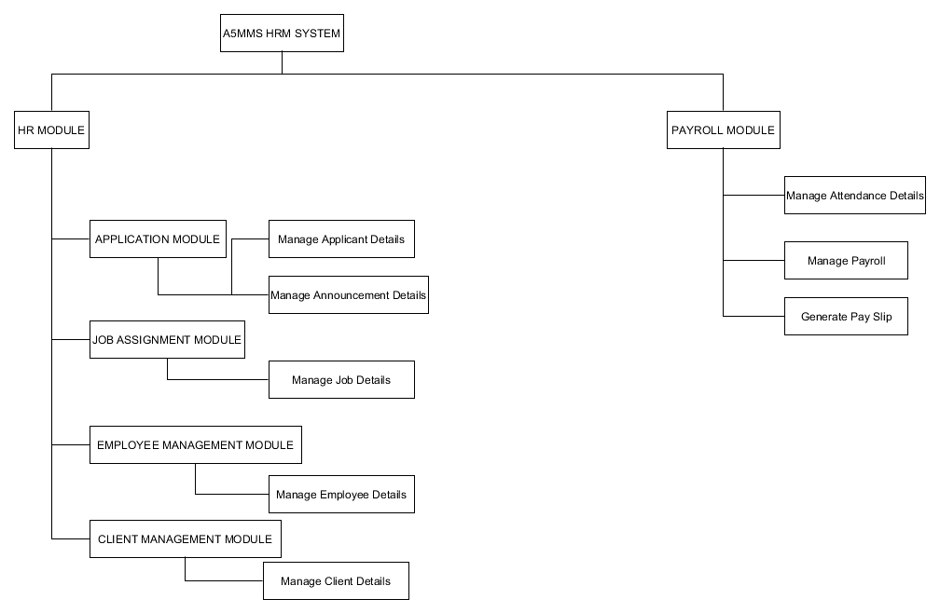
Functional Decomposition Diagram

Slide 21
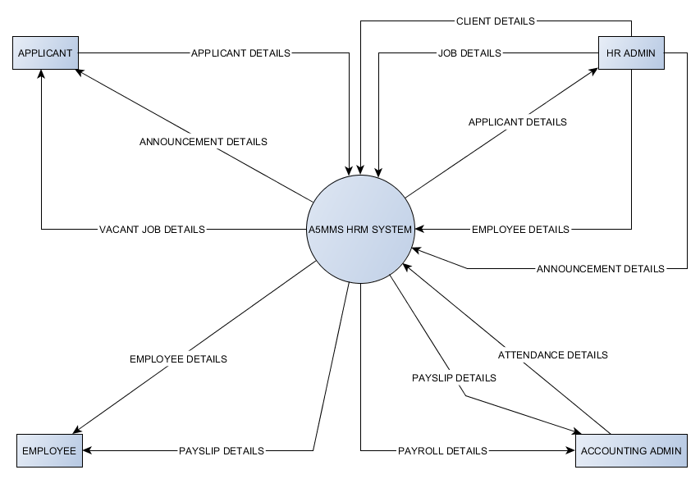
Context Diagram

Slide 22
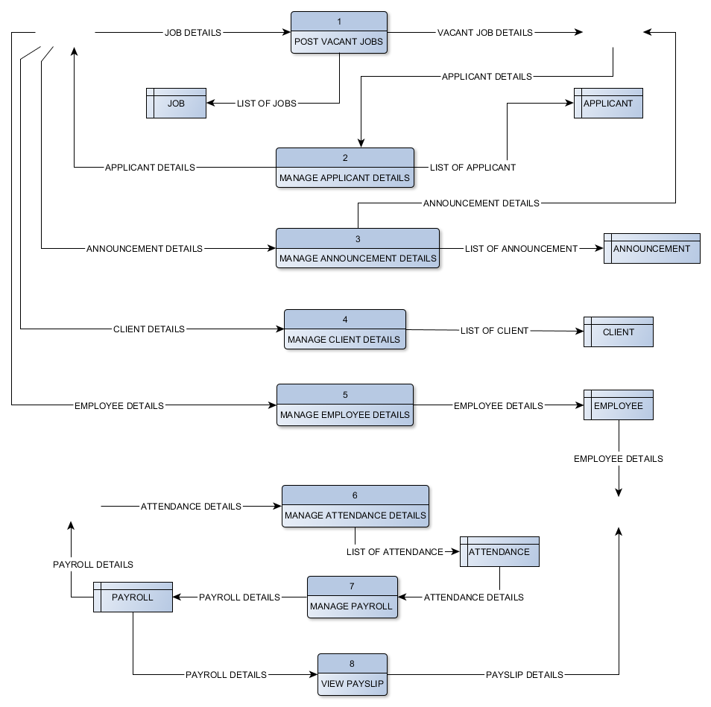
Data Flow Diagram (Diagram 0)

Slide 23
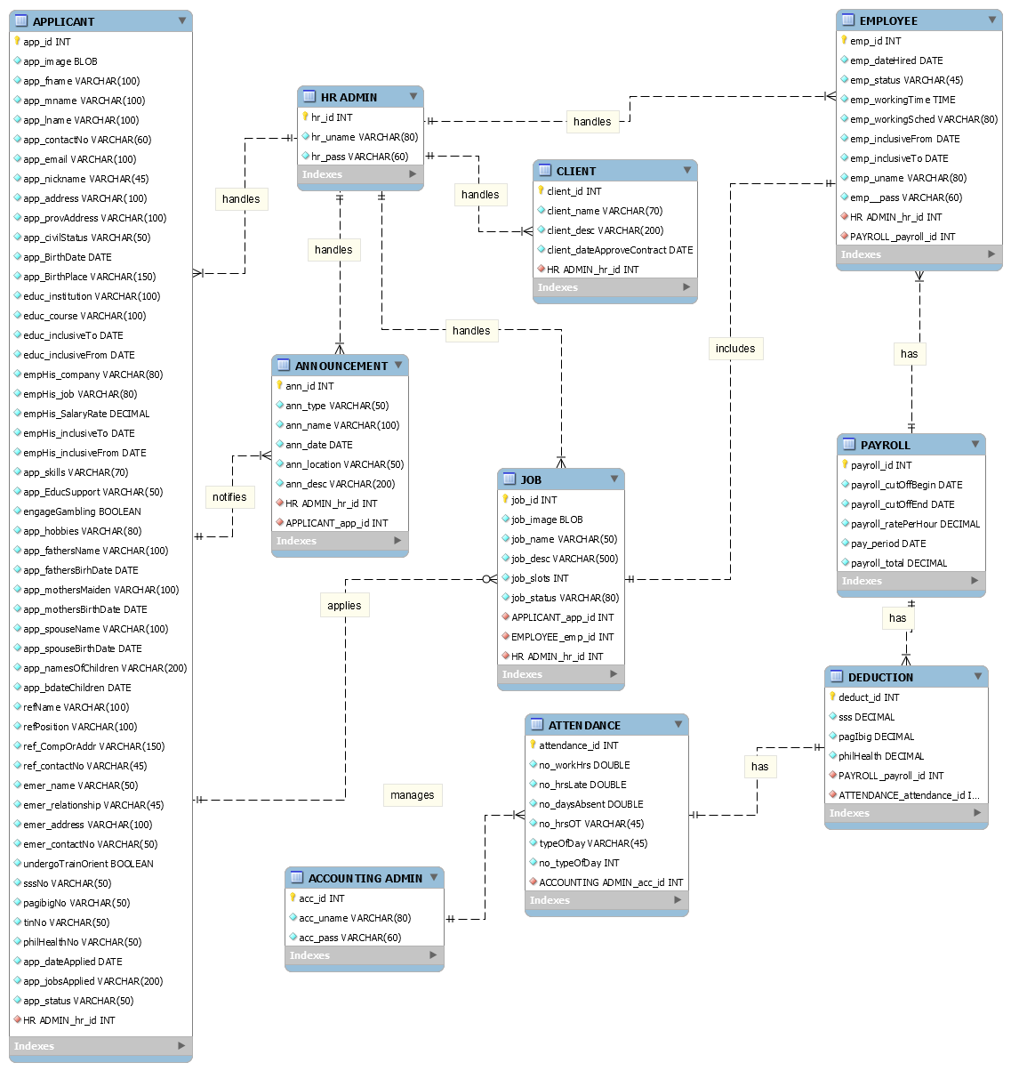
Entity Relationship Diagram

Slide 24
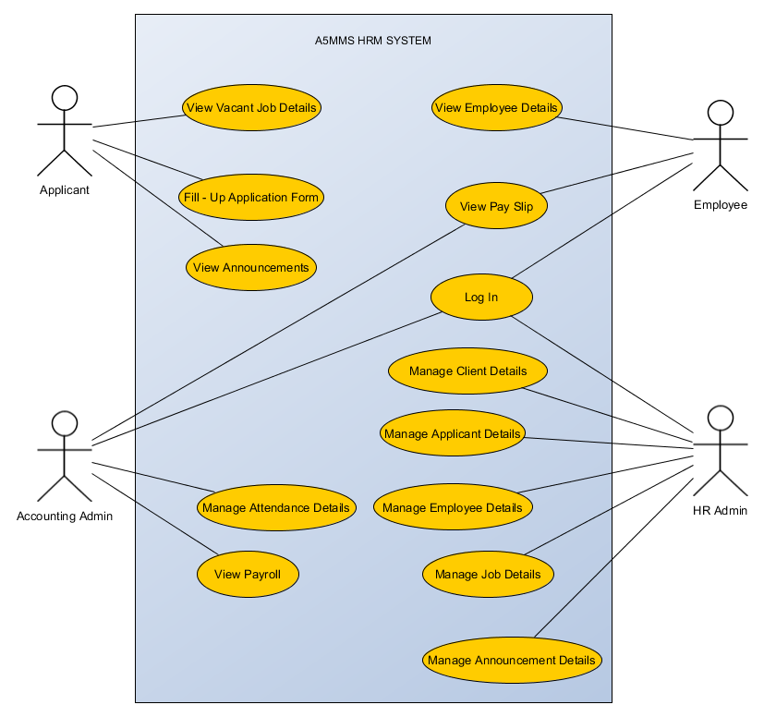
Use Case Diagram

Slide 25
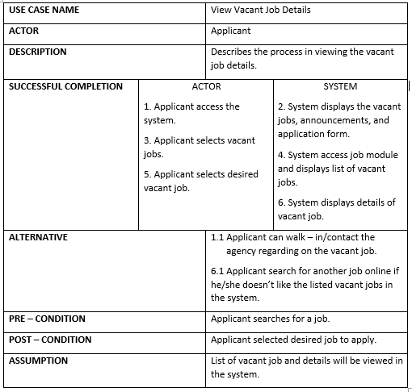
Use Case Narrative Description

Slide 26
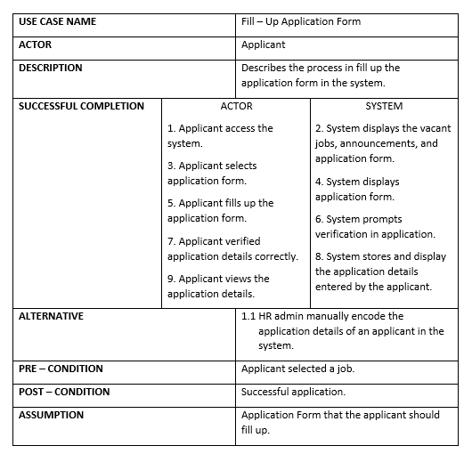
Use Case Narrative Description (continuation)

Slide 27
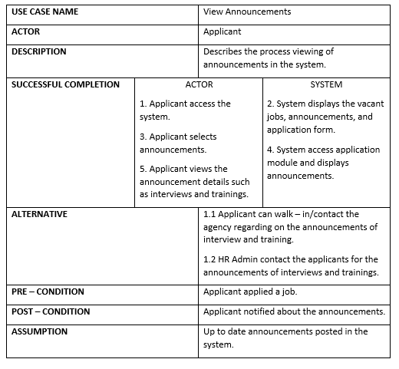
Use Case Narrative Description (continuation)

Slide 28
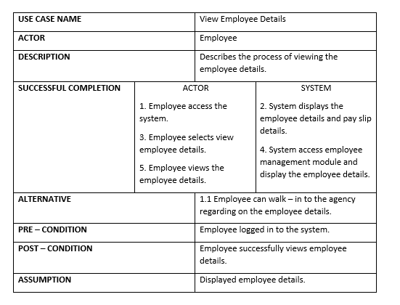
Use Case Narrative Description (continuation)

Slide 29
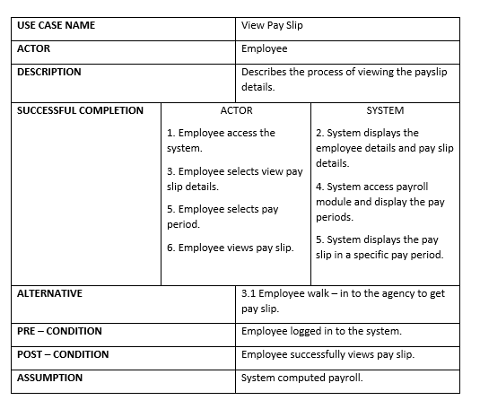
Use Case Narrative Description (continuation)

Slide 30
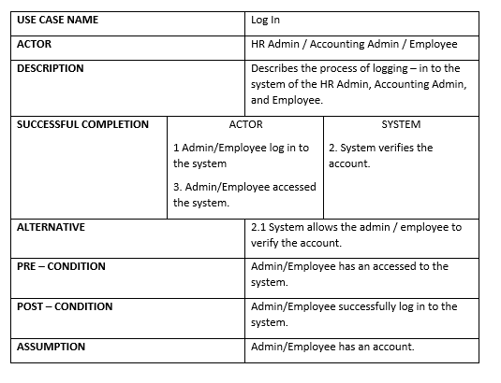
Use Case Narrative Description (continuation)

Slide 31
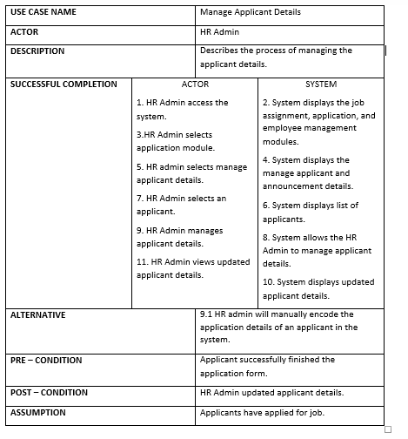
Use Case Narrative Description (continuation)

Slide 32
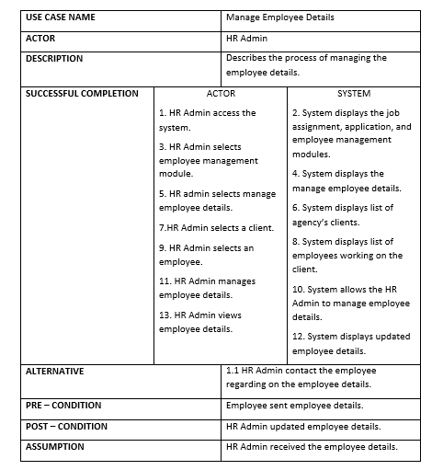
Use Case Narrative Description (continuation)

Slide 33
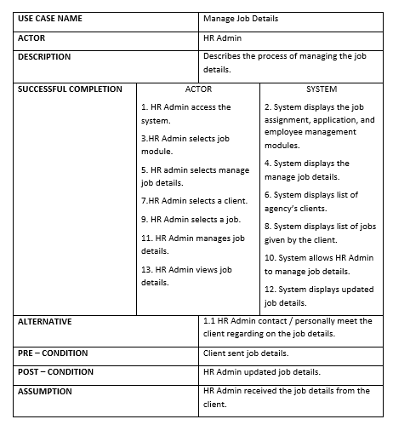
Use Case Narrative Description (continuation)

Slide 34
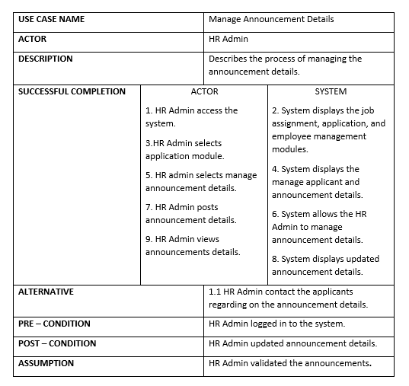
Use Case Narrative Description (continuation)

Slide 35
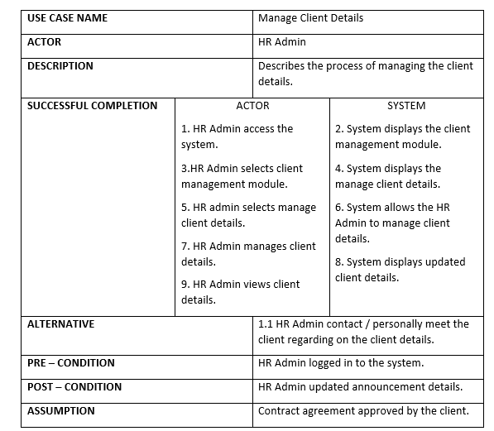
Use Case Narrative Description (continuation)

Slide 36
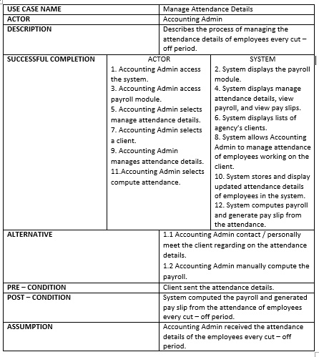
Use Case Narrative Description (continuation)

Slide 37
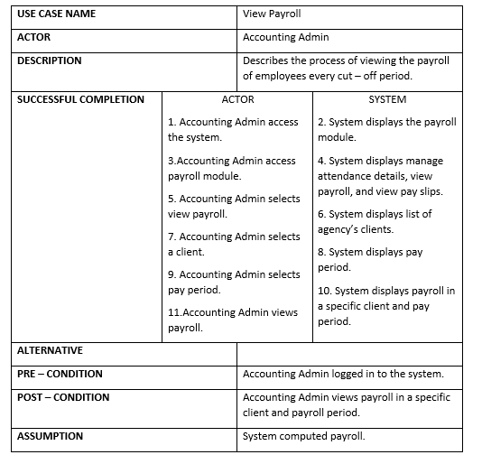
Use Case Narrative Description (continuation)

Slide 38
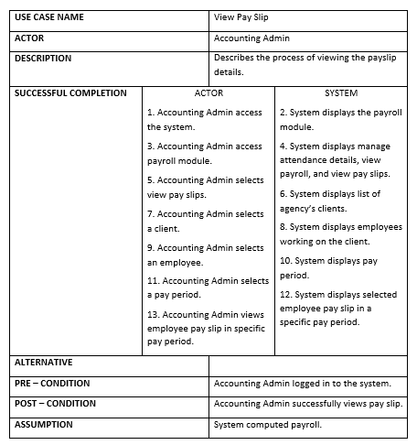
Use Case Narrative Description (continuation)

Slide 39
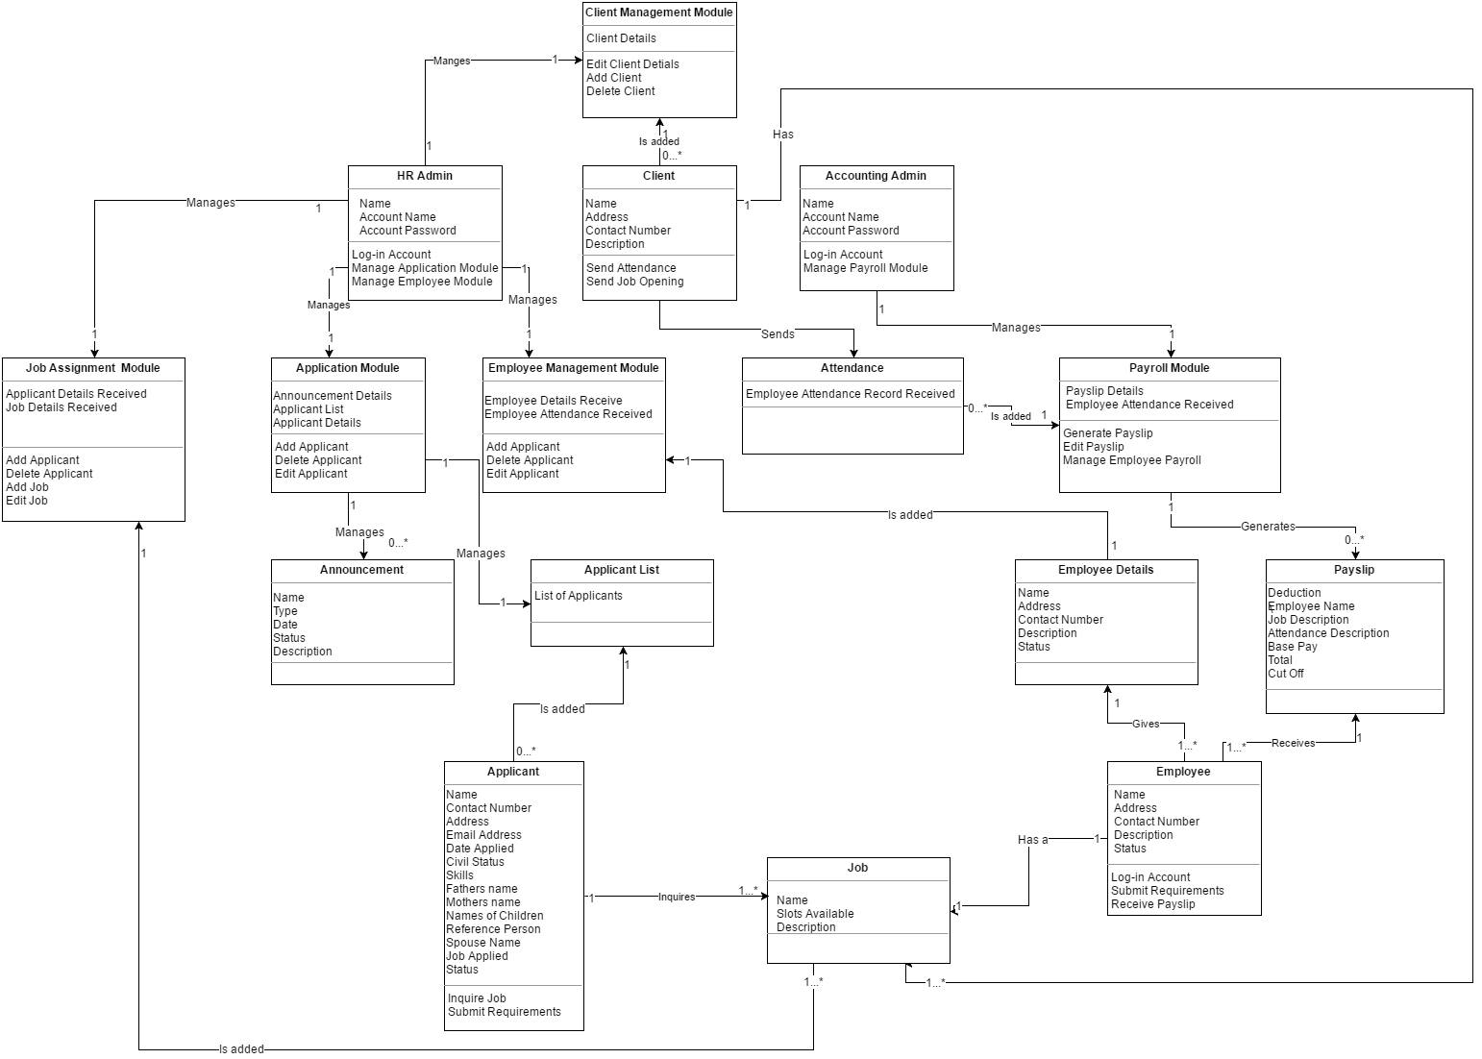
Class Diagram

Slide 40
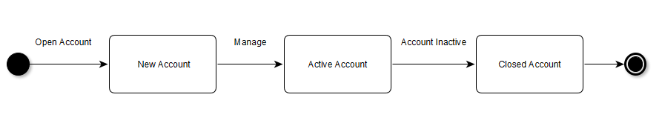
State Transition Diagrams
Employee Account
Attendance

Slide 41
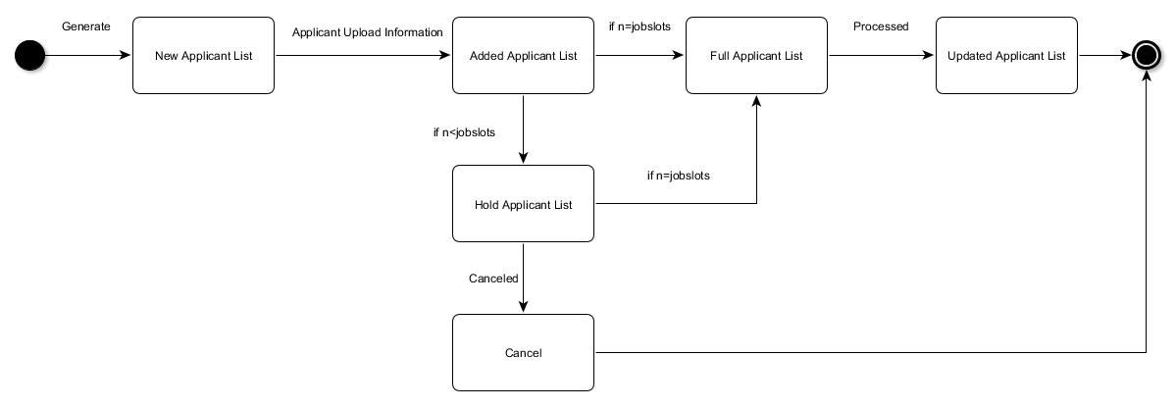
State Transition Diagrams (continuation)
Applicant List
Attendance

Slide 42
State Transition Diagrams (continuation)
Payslip

Slide 43
State Transition Diagrams (continuation)
Job

Slide 44
State Transition Diagrams (continuation)
Employee Details

Slide 45
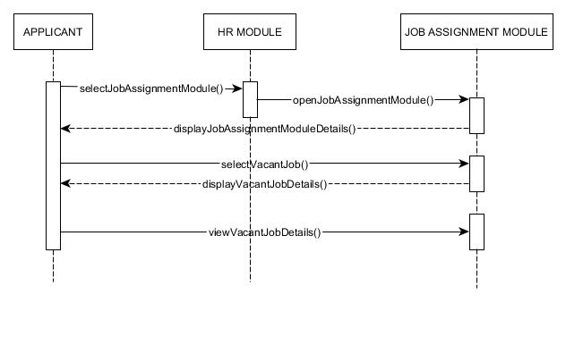
Sequence Diagrams
Applicant View Vacant Jobs

Slide 46
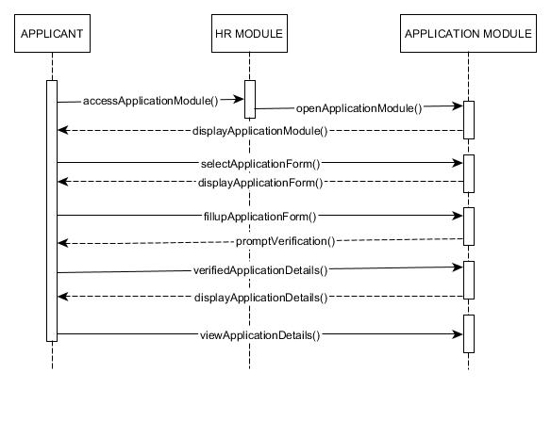
Sequence Diagrams (continuation)
Applicant Fill up Application Form

Slide 47
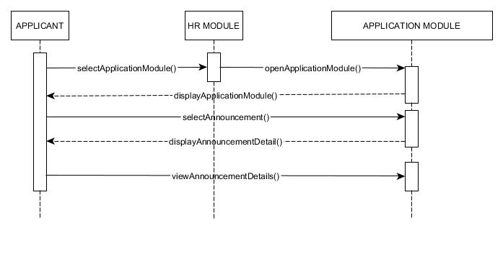
Sequence Diagrams (continuation)
Applicant View Announcements

Slide 48
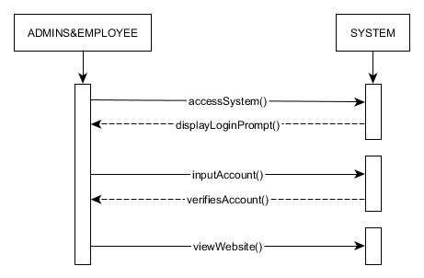
Sequence Diagrams (continuation)
HR Admin, Accounting Admin, Employee Log In

Slide 49
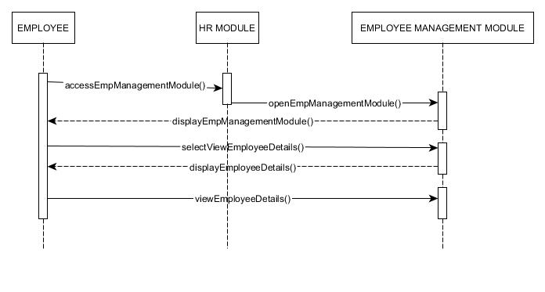
Sequence Diagrams (continuation)
Employee View Employee Details

Slide 50
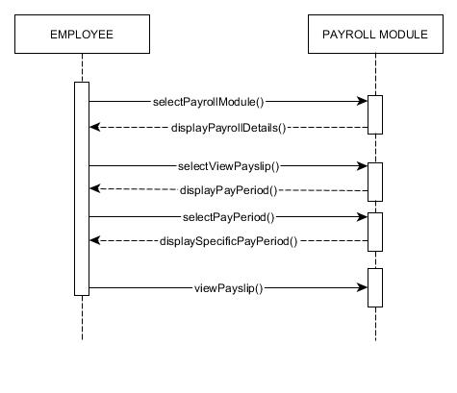
Sequence Diagrams (continuation)
Employee View Pay Slip

Slide 51
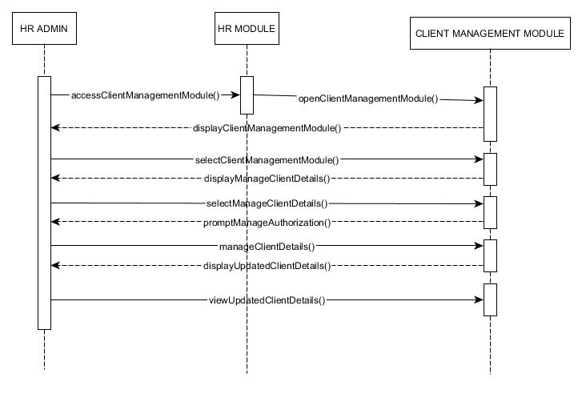
Sequence Diagrams (continuation)
HR Manage Client Details

Slide 52
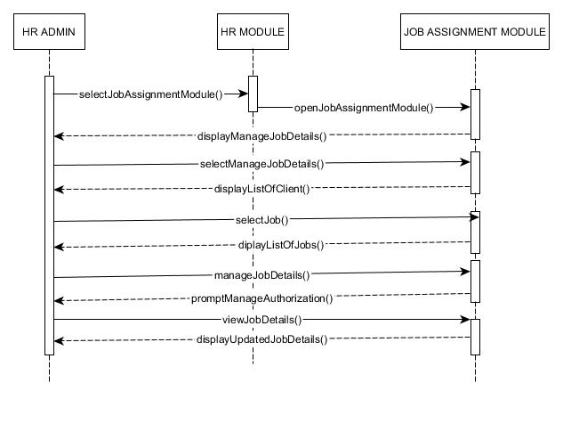
Sequence Diagrams (continuation)
HR Manage Job Details

Slide 53
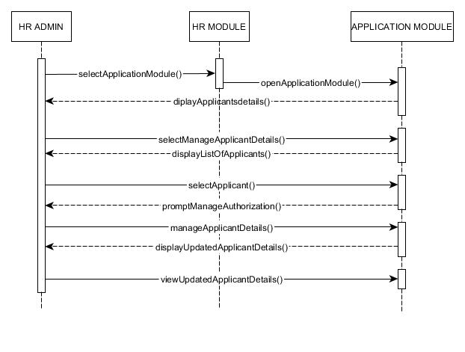
Sequence Diagrams (continuation)
HR Manage Applicant Details

Slide 54
Sequence Diagrams (continuation)
HR Manage Applicant Details

Slide 55
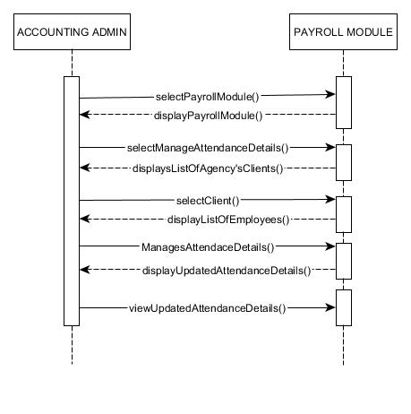
Sequence Diagrams (continuation)
Accounting Manage Attendance Details

Slide 56
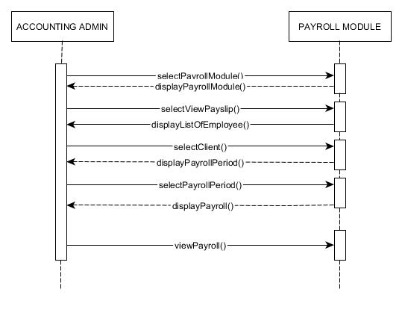
Sequence Diagrams (continuation)
Accounting View Payroll

Slide 57
Sequence Diagrams (continuation)
Accounting View Pay Slip

Slide 58
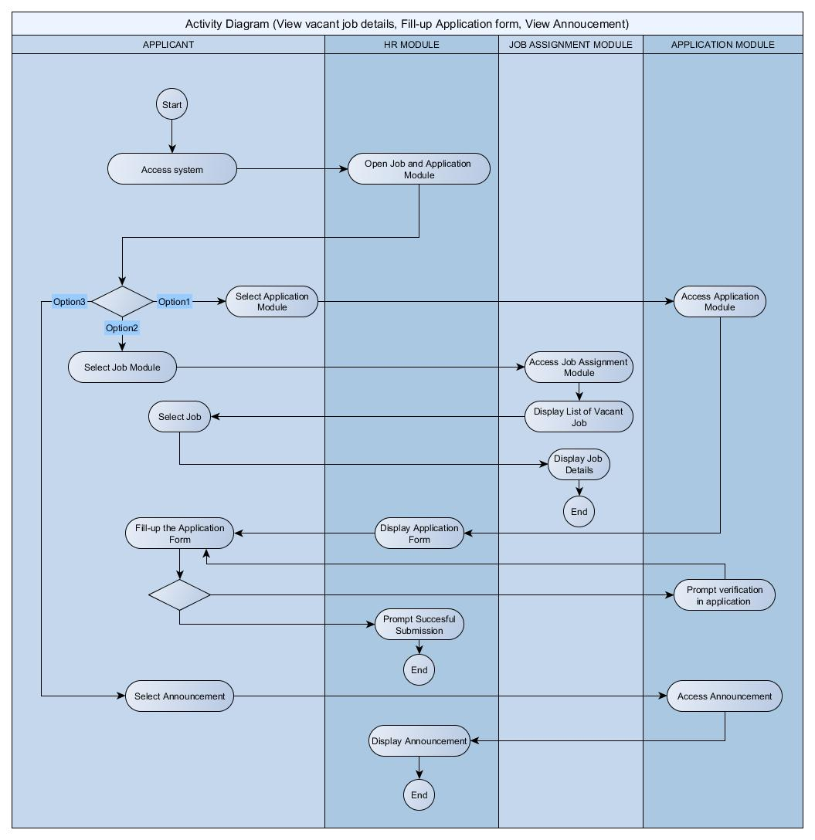
Activity Diagrams
Applicant

Slide 59
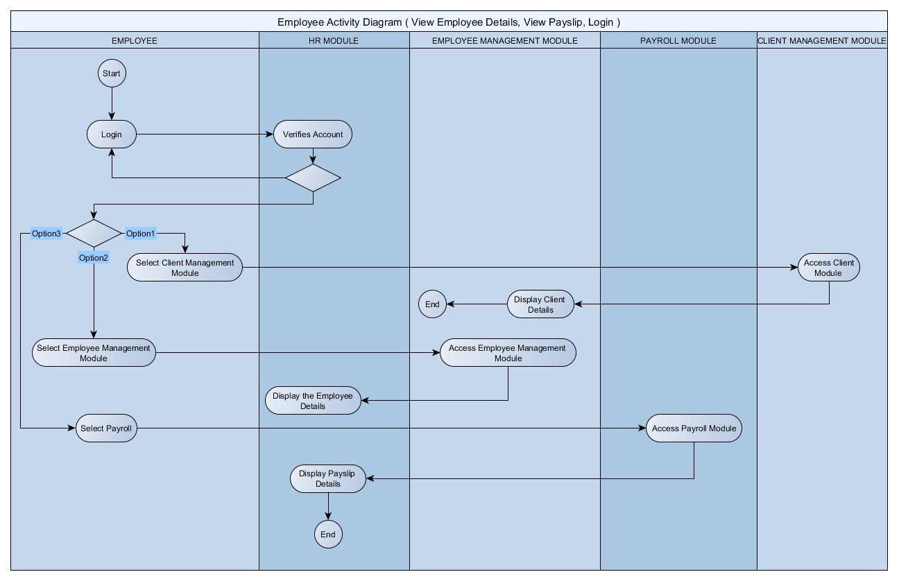
Activity Diagrams (continuation)
Employee

Slide 60
Activity Diagrams (continuation)
Employee

Slide 61
Activity Diagrams (continuation)
HR Admin Accounting Admin

Slide 62
Component Diagram

Slide 63
Deployment Diagram

Slide 64
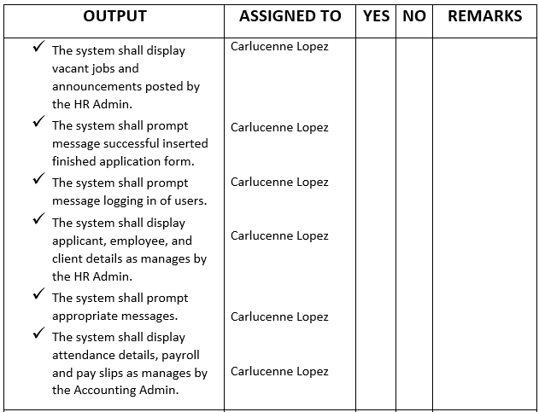
SOFTWARE REQUIREMENTS SPECIFICATION CHECKLIST

Slide 65
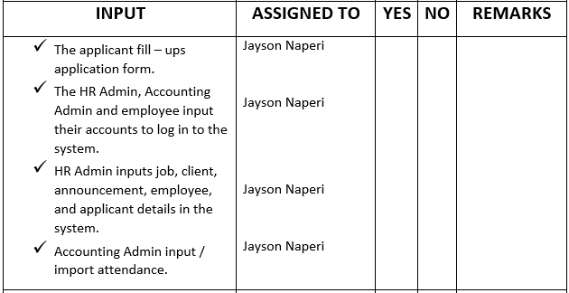
SOFTWARE REQUIREMENTS SPECIFICATION CHECKLIST (continuation)

Slide 66
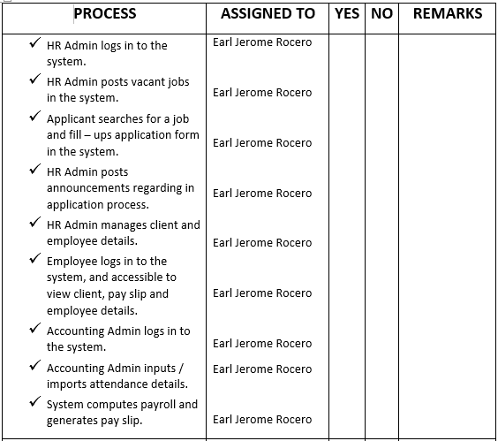
SOFTWARE REQUIREMENTS SPECIFICATION CHECKLIST (continuation)

Slide 67
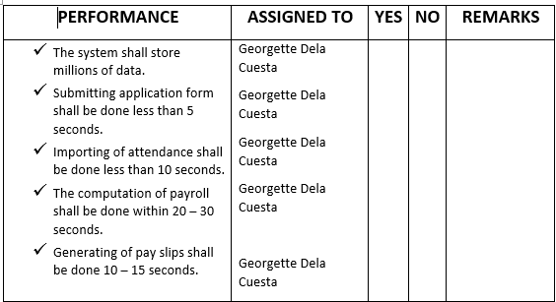
SOFTWARE REQUIREMENTS SPECIFICATION CHECKLIST (continuation)

Slide 68
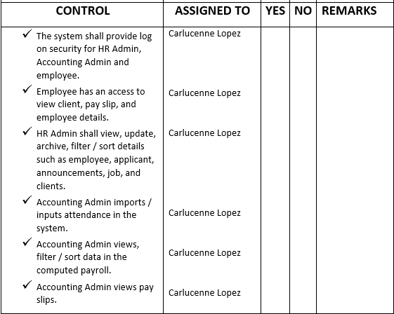
SOFTWARE REQUIREMENTS SPECIFICATION CHECKLIST (continuation)

Slide 69
Screen Layouts

Slide 70
Homepage

Slide 71
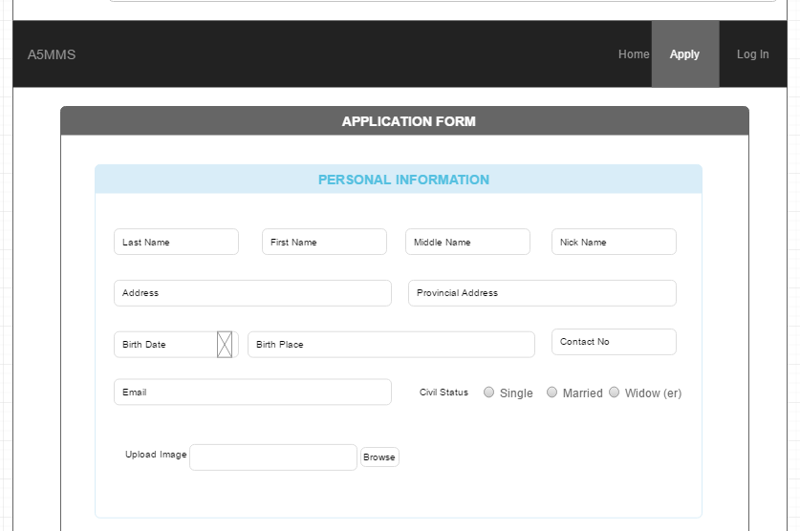
Application Form

Slide 72
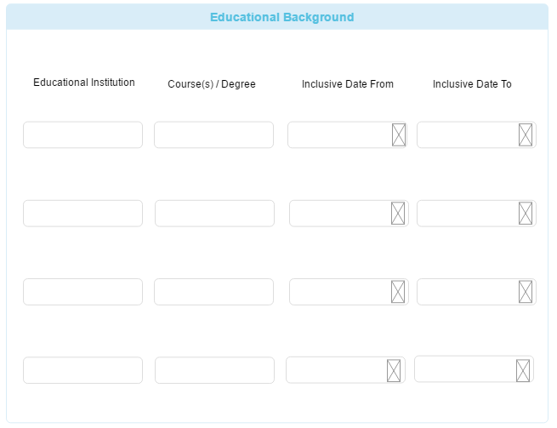
Application Form (continuation)

Slide 73
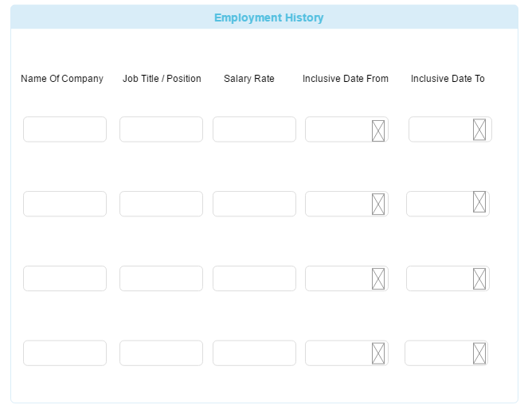
Application Form (continuation)

Slide 74

Application Form (continuation)

Slide 75

Application Form (continuation)

Slide 76

Application Form (continuation)

Slide 77
Employee Log In

Slide 78

Employee Page

Slide 79

Employee View Profile

Slide 80

Employee View Pay Slip

Slide 81

Employee View Pay Slip (continuation)

Slide 82
HR Admin / Accounting Admin Log In

Slide 83

HR Manage Applicant Page

Slide 84

View Applicants

Slide 85

Add Applicants

Slide 86

Archive Applicants

Slide 87
HR Manage Announcements

Slide 88

HR Manage Job Page

Slide 89

HR View Job

Slide 90

HR Post Job

Slide 91

HR Manage Employee Page

Slide 92

HR View Employees

Slide 93

HR Add Employee

Slide 94

Accounting Admin Manage Attendance

Slide 95
Accounting Admin Manage Attendance

Slide 96

Accounting Admin View Payroll

Slide 97

Accounting View Pay Slips

